Slide 1
Bitmap Indexes
Bitmap Indexing
Notes:
1

Slide 2
Bitmap Indices
Bitmap indices are a special type of index designed for efficient querying on multiple keys
Records in a relation are assumed to be numbered sequentially from, say, 0
Given a number n it must be easy to retrieve record n
Particularly easy if records are of fixed size
Applicable on attributes that take on a relatively small number of distinct values
E.g. gender, country, state, …
E.g. income-level (income broken up into a small number of levels such as 0-9999, 10000-19999, 20000-50000, 50000- infinity)
A bitmap is simply an array of bits

Slide 3
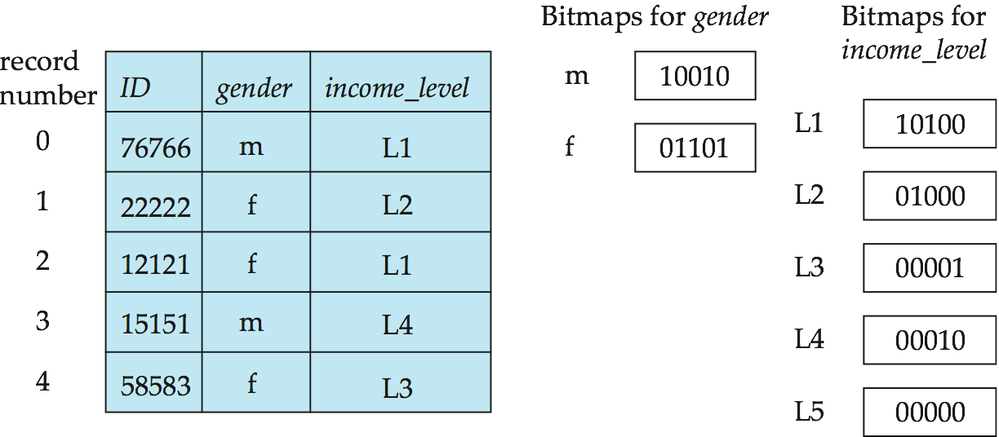
Bitmap Indices (Cont.)
In its simplest form a bitmap index on an attribute has a bitmap for each value of the attribute
Bitmap has as many bits as records
In a bitmap for value v, the bit for a record is 1 if the record has the value v for the attribute, and is 0 otherwise

Slide 4
Bitmap Indices (Cont.)
Bitmap indices are useful for queries on multiple attributes
not particularly useful for single attribute queries
Queries are answered using bitmap operations
Intersection (and)
Union (or)
Complementation (not)
Each operation takes two bitmaps of the same size and applies the operation on corresponding bits to get the result bitmap
E.g. 100110 AND 110011 = 100010
100110 OR 110011 = 110111 NOT 100110 = 011001
Males with income level L1: 10010 AND 10100 = 10000
Can then retrieve required tuples.
Counting number of matching tuples is even faster

Slide 5
Bitmap Index---Definition
A collection of bit-vectors of length n
n means the total number of records
Each bit of this vector stands for one possible values that may appear in this field.
At position i for the vector of value v, if the i ^{th} record have value v , then the value of vector bit i is “1”. otherwise “0”

Slide 6
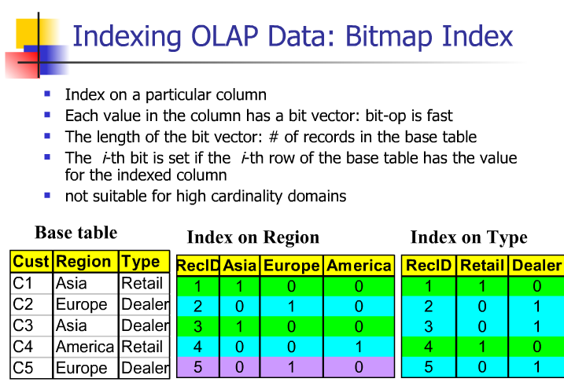

Slide 7
Example 1. How the bitmap index forms
Sample Relation R(F,G)
F | G
30 | foo
30 | bar
40 | baz
50 | foo
40 | bar
30 | baz
Tuple # 1
Tuple # 2
Tuple # 3
Tuple # 4
Tuple # 5
Tuple # 6

Slide 8
Example 1. How the bitmap index forms (continue..)
Let’s see field “F”
How many DISTINCT values ?
3 (30,40,50)
so, the total number of tuples in the bitmap index is 3.
How many records ?
6
so, the length of bit-vector is 6.

Slide 9
Example 1. How the bitmap index forms (continue..)
Distinct value: 3
Total tuple : 6
Bitmap index:
value | Bit-vector
30 | xxxxxx
40 | xxxxxx
50 | xxxxxx
Distinct values:
Length of Bit-Vector is 6

Slide 10
Example 1. How the bitmap index forms (continue..)
How to form bit-vector ?
Let’s see Value 30
Which Tuples has the value 30 in field F?
(1, 2, 6)
value | Bit-vector
30 | xxxxxx
40 | xxxxxx
50 | xxxxxx

Slide 11
Example 1. How the bitmap index forms (continue..)
So, the bit-vector of value 30 is :
Tuple1 | Tuple2 | Tuple3 | Tuple4 | Tuple5 | Tuple6
1 | 1 | 0 | 0 | 0 | 1

Slide 12
Example 1. How the bitmap index forms
Fill the bit-map index of Field “F” as following:
value | Bit-vector
30 | 1 1 0 0 0 1
40 | 0 0 1 0 1 0
50 | 0 0 0 1 0 0

Slide 13
Do we need Bitmap-Index?
How to find the i ^{th} record in a bitmap index?

Slide 14
Advantage of Bitmap Index
Accelerate the search.
Example 2
Consider following Relation:
Movie (title, year, length, studioName)
We need to run the following query:
SELECT title
FROM Movie
WHERE studioName = ‘Disney’ AND
year = 1995;

Slide 15
Example 2. (contiue…)
With following tuples:
studioName | year
Disney | 1995
MGM | 1996
DreamFactory | 2000
MGM | 1995
DreamFactory | 1996
Disney | 2000

Slide 16
Example 2. (contiue…)
Suppose we build Bitmap index in the field of “studioName” and “year”
Bitmap Index on Field “studioName”
Disney | 1 0 0 0 0 1
MGM | 0 1 0 1 0 0
DreamFactory | 0 0 1 0 1 0
Bitmap Index on Field “studioName”
1995 | 1 0 0 1 0 0
1996 | 0 1 0 0 0 0
2000 | 0 0 1 0 0 1

Slide 17
Example 2. (contiue…)
The query is :
SELECT title
FROM Movie
WHERE studioName = ‘Disney’ AND
year = 1995;
So we INTERSECT the bitmap index with value of ‘Disney” and ‘1995’
 | 1 0 0 0 0 1
AND | 1 0 0 1 0 0
 | 1 0 0 0 0 0
Answer: tuple #1

Slide 18
Bitmap Indices (Cont.)
Bitmap indices generally very small compared with relation size
E.g. if record is 100 bytes, space for a single bitmap is 1/800 of space used by relation.
If number of distinct attribute values is 8, bitmap is only 1% of relation size
Deletion needs to be handled properly
Existence bitmap to note if there is a valid record at a record location
Needed for complementation
not(A=v): (NOT bitmap-A-v) AND ExistenceBitmap
Should keep bitmaps for all values, even null value
To correctly handle SQL null semantics for NOT(A=v):
intersect above result with (NOT bitmap-A-Null)

Slide 19
Efficient Implementation of Bitmap Operations
Bitmaps are packed into words; a single word and (a basic CPU instruction) computes and of 32 or 64 bits at once
E.g. 1-million-bit maps can be and-ed with just 31,250 instruction
Counting number of 1s can be done fast by a trick:
Use each byte to index into a precomputed array of 256 elements each storing the count of 1s in the binary representation
Can use pairs of bytes to speed up further at a higher memory cost
Add up the retrieved counts
Bitmaps can be used instead of Tuple-ID lists at leaf levels of B⁺-trees, for values that have a large number of matching records
Worthwhile if > 1/64 of the records have that value, assuming a tuple-id is 64 bits
Above technique merges benefits of bitmap and B⁺-tree indices

Slide 20
Index Definition in SQL
Create an index
create index <index-name> on <relation-name> (<attribute-list>)
E.g.: create index b-index on branch(branch_name)
Use create unique index to indirectly specify and enforce the condition that the search key is a candidate key is a candidate key.
Not really required if SQL unique integrity constraint is supported
To drop an index
drop index <index-name>
Most database systems allow specification of type of index, and clustering.

